Slide 1
CSC 578 Neural Networks and Deep Learning
Fall 2018/19
3. Improving Neural Networks
(Some figures adapted from NNDL book)

Slide 2
Various Approaches to Improve Neural Networks
Cost functions
Quadratic
Cross Entropy
Log likelihood
Regularization
L2 regularization
L1 regularization
Dropout
Data expansion
Initial weights
Hyper-parameters
Hessian technique
Momentum
Other approaches to minimize error/cost
Conjugate gradient
L-BFGS
Other Activation/transfer functions
Tanh
Rectified Linear Unit (ReLU)
Softmax

Slide 3

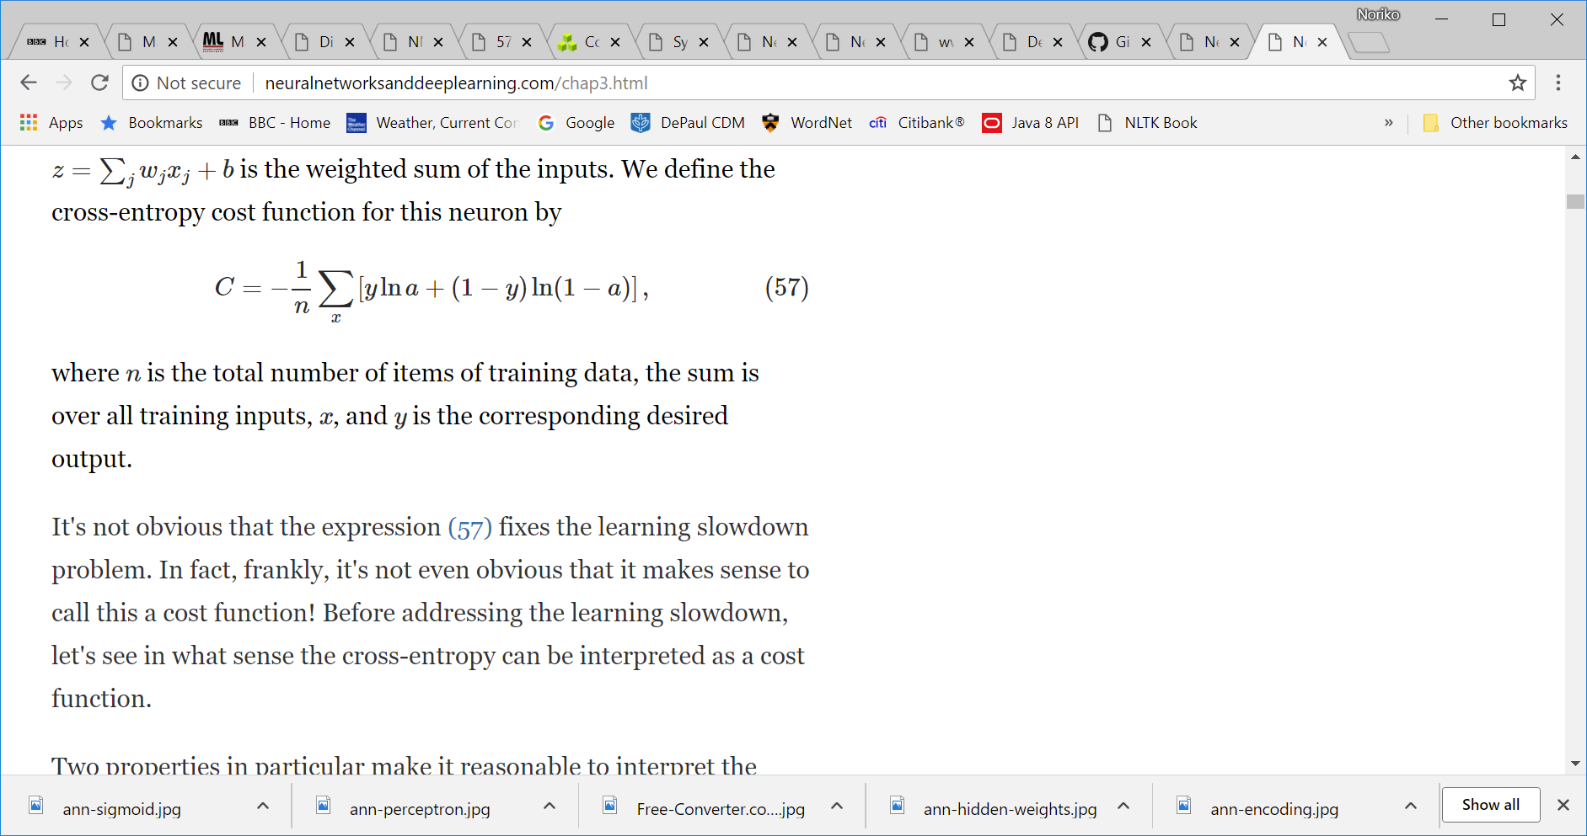
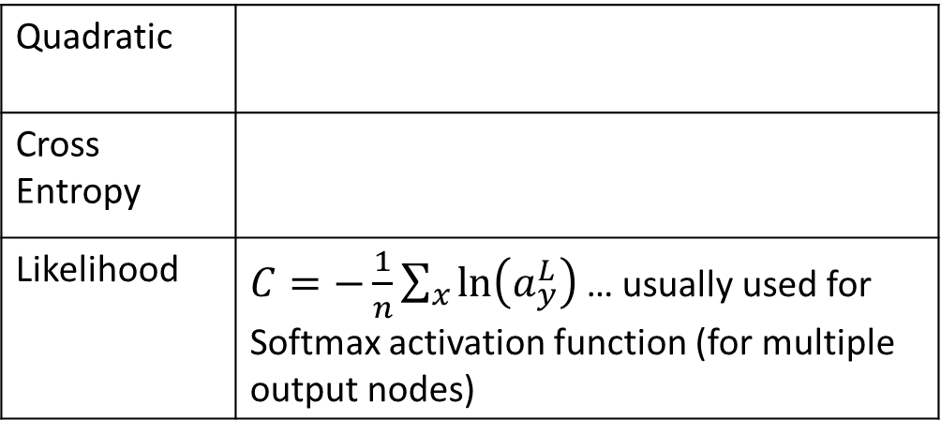
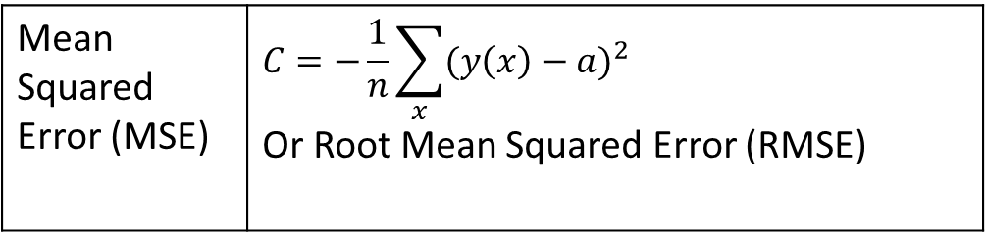
1 Various Cost Functions
For classification:
For regression:
Quadratic
Cross Entropy
Likelihood | $C=−\frac{1}{n}\sum_{x}{\ln\left(a_{y}^{L}\right)}$ … usually used for Softmax activation function (for multiple output nodes)
Mean Squared Error (MSE) | $$C=−\frac{1}{n}\sum_{x}{{(y\left(x\right)−a)}^{2}}$$ Or Root Mean Squared Error (RMSE)

Slide 4
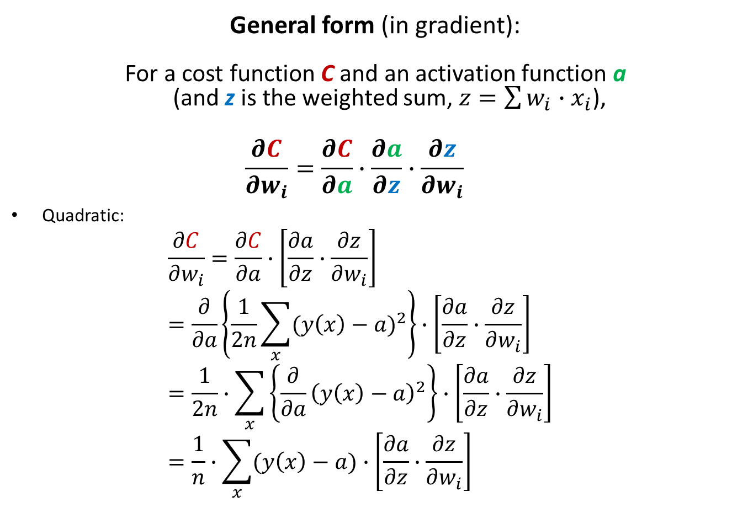
Differentials of Cost Functions
General form (in gradient):
For a cost function C and an activation function a (and z is the weighted sum, $z=\sum{w_{i}∙x_{i}}$),
$$\frac{∂C}{∂w_{i}}=\frac{∂C}{∂a}∙\frac{∂a}{∂z}∙\frac{∂z}{∂w_{i}}$$
Quadratic: $\frac{∂C}{∂w_{i}}=\frac{∂C}{∂a}∙\left[\frac{∂a}{∂z}∙\frac{∂z}{∂w_{i}}\right]$ $=\frac{∂}{∂a}\left\{\frac{1}{2n}\sum_{x}{{(y\left(x\right)−a)}^{2}}\right\}∙\left[\frac{∂a}{∂z}∙\frac{∂z}{∂w_{i}}\right]$ $=\frac{1}{2n}∙\sum_{x}{\left\{{\frac{∂}{∂a}\left(y\left(x\right)−a\right)}^{2}\right\}∙\left[\frac{∂a}{∂z}∙\frac{∂z}{∂w_{i}}\right]}$ $=\frac{1}{n}∙\sum_{x}{(y\left(x\right)−a)∙\left[\frac{∂a}{∂z}∙\frac{∂z}{∂w_{i}}\right]}$

Slide 5
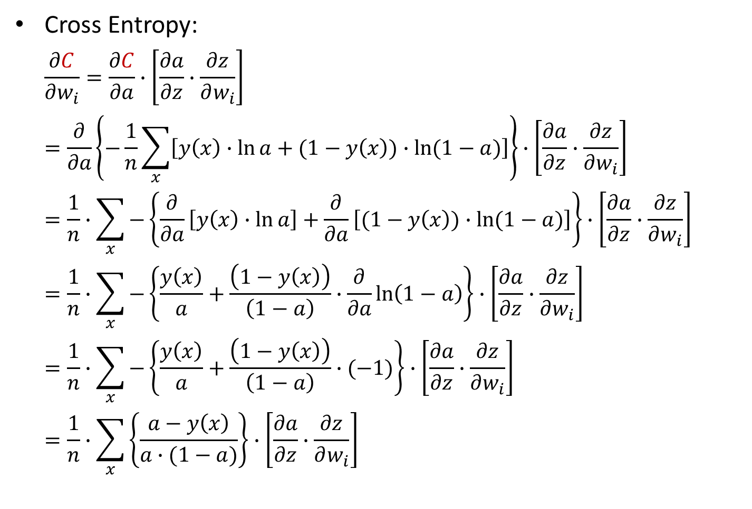
Cross Entropy: $\frac{∂C}{∂w_{i}}=\frac{∂C}{∂a}∙\left[\frac{∂a}{∂z}∙\frac{∂z}{∂w_{i}}\right]$ $=\frac{∂}{∂a}\left\{−\frac{1}{n}\sum_{x}{\left[y\left(x\right)∙\ln{a}+(1−y\left(x\right))∙\ln{(1−a)}\right]}\right\}∙\left[\frac{∂a}{∂z}∙\frac{∂z}{∂w_{i}}\right]$ $=\frac{1}{n}∙\sum_{x}{−\left\{\frac{∂}{∂a}\left[y\left(x\right)∙\ln{a}\right]+\frac{∂}{∂a}\left[(1−y\left(x\right))∙\ln{(1−a)}\right]\right\}∙\left[\frac{∂a}{∂z}∙\frac{∂z}{∂w_{i}}\right]}$ $=\frac{1}{n}∙\sum_{x}{−\left\{\frac{y\left(x\right)}{a}+\frac{\left(1−y\left(x\right)\right)}{\left(1−a\right)}∙\frac{∂}{∂a}\ln\left(1−a\right)\right\}∙\left[\frac{∂a}{∂z}∙\frac{∂z}{∂w_{i}}\right]}$ $=\frac{1}{n}∙\sum_{x}{−\left\{\frac{y\left(x\right)}{a}+\frac{\left(1−y\left(x\right)\right)}{\left(1−a\right)}∙(−1)\right\}∙\left[\frac{∂a}{∂z}∙\frac{∂z}{∂w_{i}}\right]}$ $=\frac{1}{n}∙\sum_{x}{\left\{\frac{a−y\left(x\right)}{a∙(1−a)}\right\}∙\left[\frac{∂a}{∂z}∙\frac{∂z}{∂w_{i}}\right]}$

Slide 6
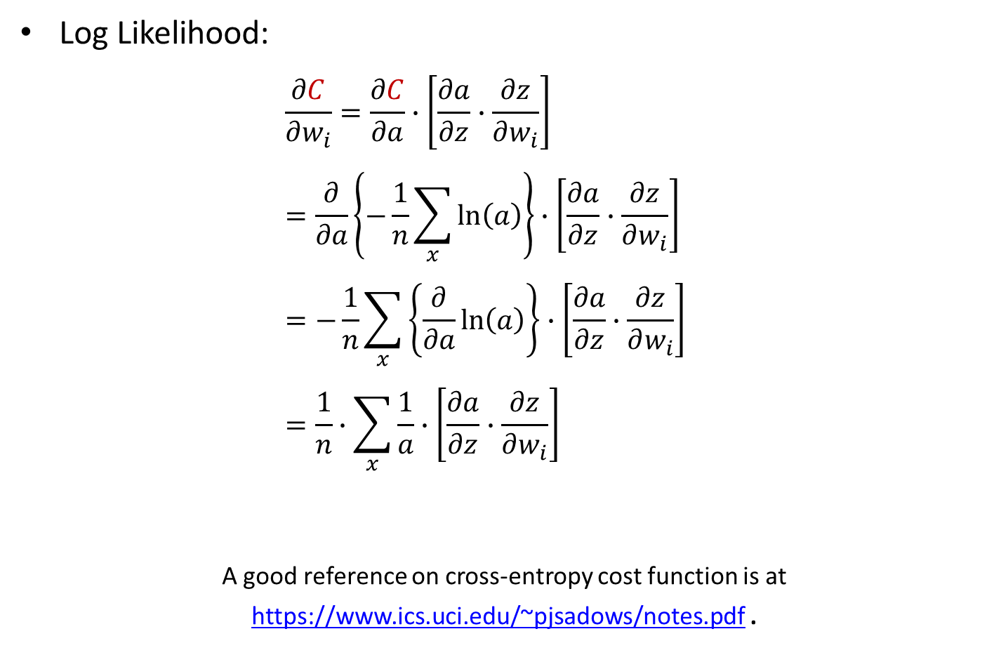
Log Likelihood: $\frac{∂C}{∂w_{i}}=\frac{∂C}{∂a}∙\left[\frac{∂a}{∂z}∙\frac{∂z}{∂w_{i}}\right]$ $=\frac{∂}{∂a}\left\{−\frac{1}{n}\sum_{x}{\ln\left(a\right)}\right\}∙\left[\frac{∂a}{∂z}∙\frac{∂z}{∂w_{i}}\right]$ $=−\frac{1}{n}\sum_{x}{\left\{\frac{∂}{∂a}\ln\left(a\right)\right\}}∙\left[\frac{∂a}{∂z}∙\frac{∂z}{∂w_{i}}\right]$ $=\frac{1}{n}∙\sum_{x}{\frac{1}{a}∙\left[\frac{∂a}{∂z}∙\frac{∂z}{∂w_{i}}\right]}$
A good reference on cross-entropy cost function is at https://www.ics.uci.edu/~pjsadows/notes.pdf .

Slide 7

1.1 Cross Entropy
Since sigmoid curve is flat on both ends, cost functions whose gradient include sigmoid is slow to converge (to minimize the cost), especially when the output is very far from the target.
Using sigmoid neurons but with a different cost function, in particular Cross Entropy, helps speed up convergence.
With Cross Entropy, C is always > 0.
where y is the target output, and a = network output

Slide 8
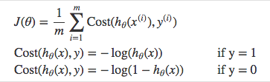
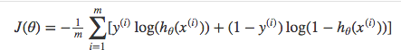
Cross-entropy cost (or ‘loss’) can be divided into two separate cost functions: one for y=1 and one for y=0. The two cases are combined into one expression (since the cases are mutually exclusive). If y=0, the first side cancels out. If y=1, the second side cancels out. In both cases we only perform the operation we need to perform.

Slide 9
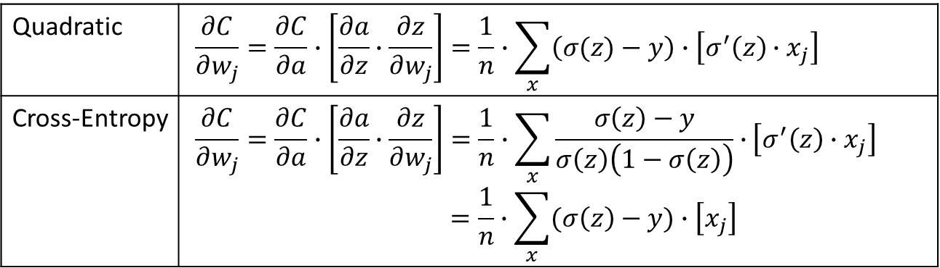
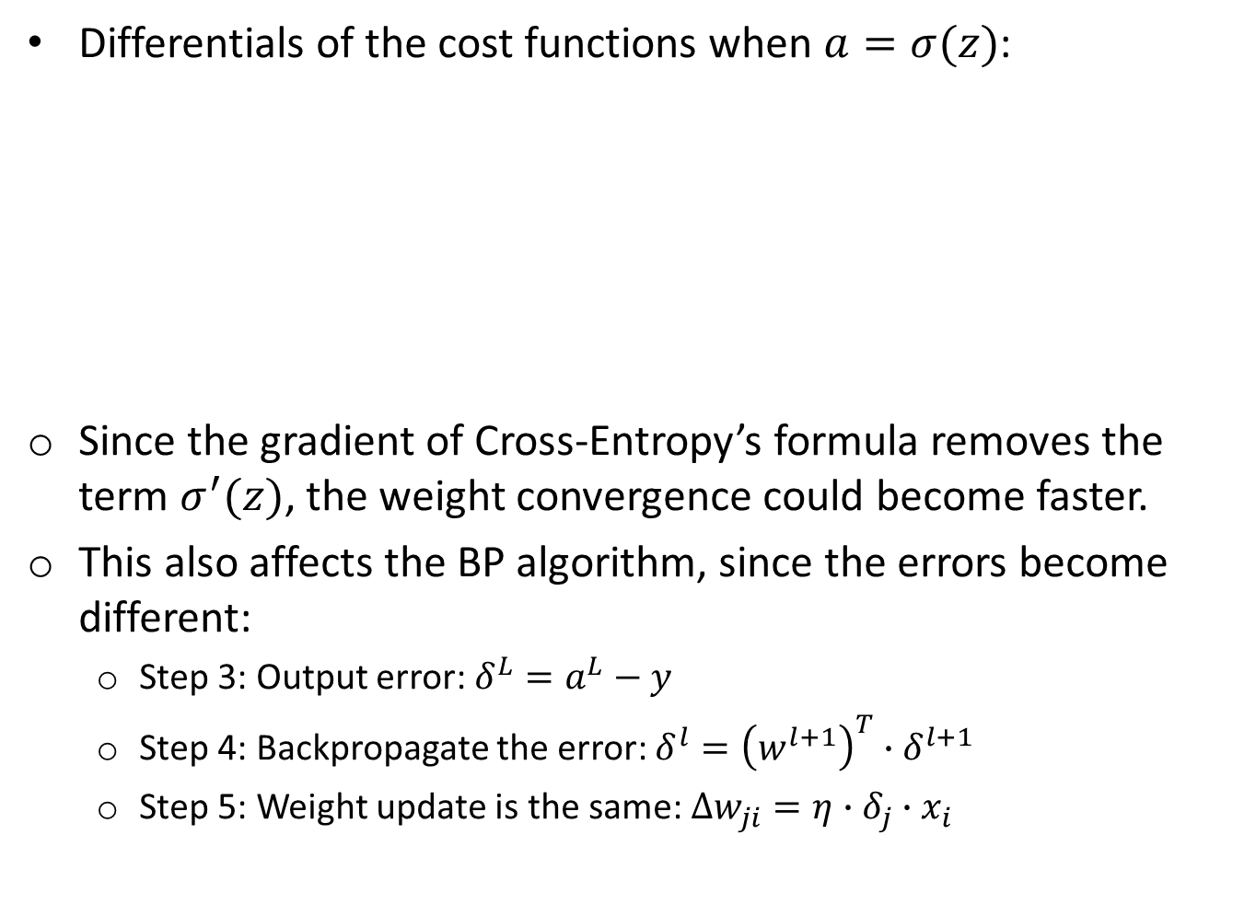
Differentials of the cost functions when $a=σ(z)$:
Since the gradient of Cross-Entropy’s formula removes the term $σ^{′}(z)$, the weight convergence could become faster.
This also affects the BP algorithm, since the errors become different:
Step 3: Output error: $δ^{L}=a^{L}−y$
Step 4: Backpropagate the error: $δ^{l}={\left(w^{l+1}\right)}^{T}∙δ^{l+1}$
Step 5: Weight update is the same: $∆w_{ji}=η∙δ_{j}∙x_{i}$
Quadratic | $$\frac{∂C}{∂w_{j}}=\frac{∂C}{∂a}∙\left[\frac{∂a}{∂z}∙\frac{∂z}{∂w_{j}}\right]=\frac{1}{n}∙\sum_{x}{\left(σ(z)−y\right)}∙\left[σ^{′}\left(z\right)∙x_{j}\right]$$
Cross-Entropy | $$\frac{∂C}{∂w_{j}}=\frac{∂C}{∂a}∙\left[\frac{∂a}{∂z}∙\frac{∂z}{∂w_{j}}\right]=\frac{1}{n}∙\sum_{x}{\frac{σ\left(z\right)−y}{σ\left(z\right)\left(1−σ\left(z\right)\right)}∙}\left[σ^{′}\left(z\right)∙x_{j}\right] \\ =\frac{1}{n}∙\sum_{x}{(σ\left(z\right)−y)}∙\left[x_{j}\right]$$

Slide 10
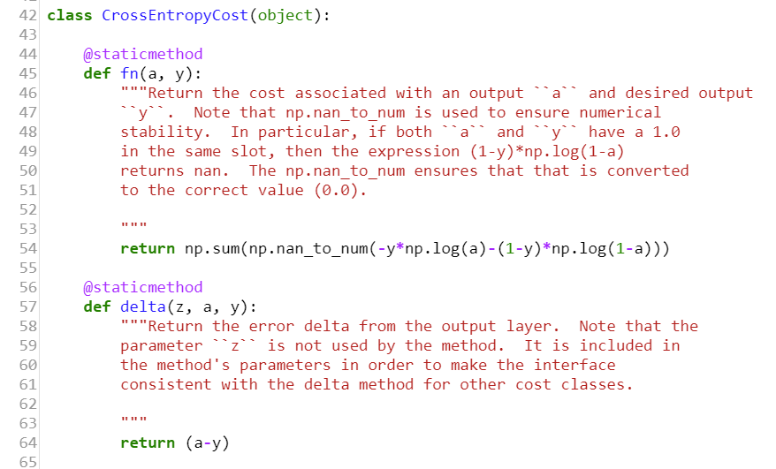

Slide 11
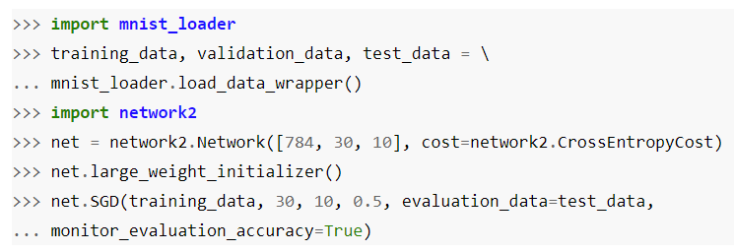
You can specify the cost function in the constructor call (by “cost=…”).

Slide 12
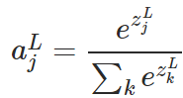
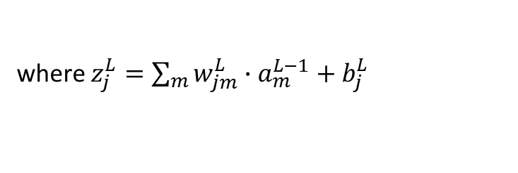
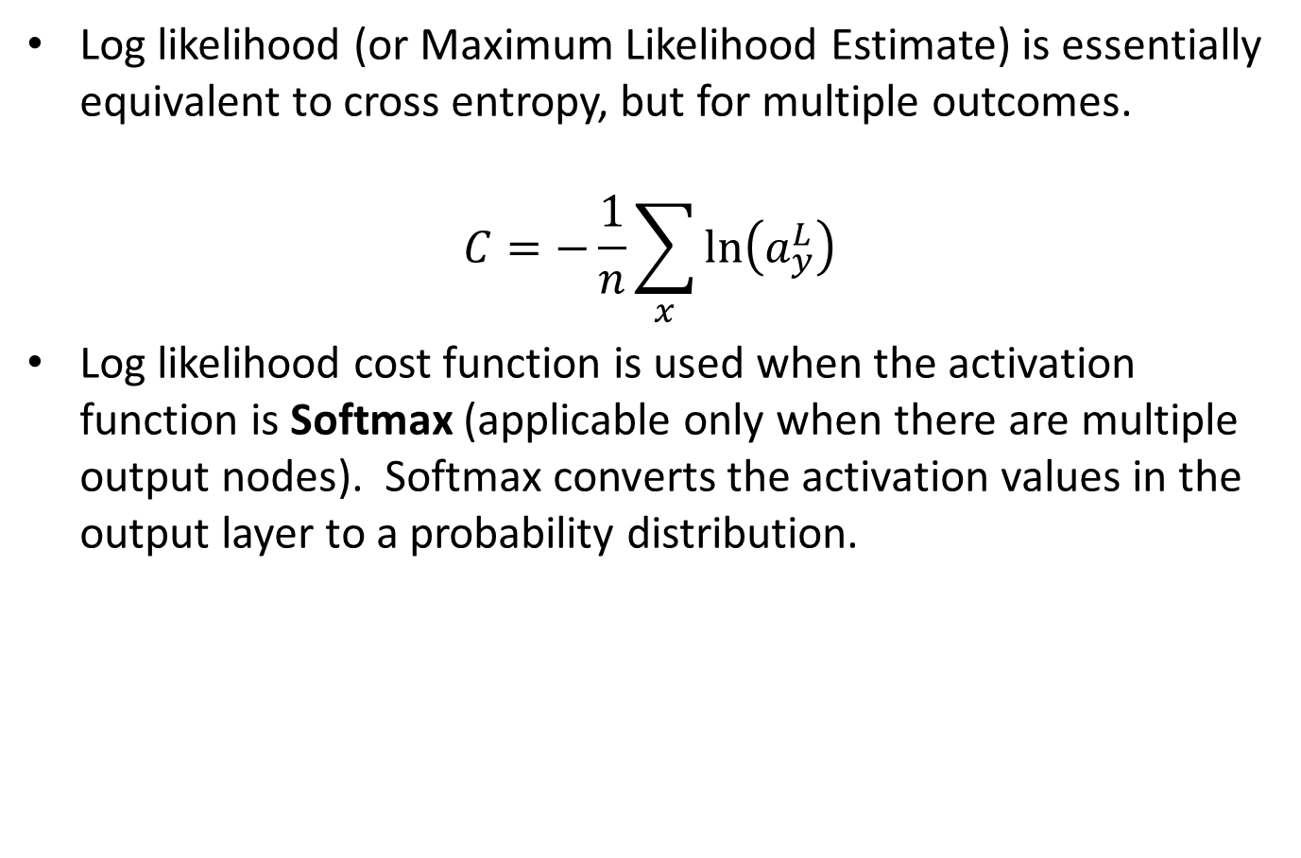
1.2 Log Likelihood
Log likelihood (or Maximum Likelihood Estimate) is essentially equivalent to cross entropy, but for multiple outcomes.
$$C=−\frac{1}{n}\sum_{x}{\ln\left(a_{y}^{L}\right)}$$
Log likelihood cost function is used when the activation function is Softmax (applicable only when there are multiple output nodes). Softmax converts the activation values in the output layer to a probability distribution.
where $z_{j}^{L}=\sum_{m}{w_{jm}^{L}∙a_{m}^{L−1}+b_{j}^{L}}$

Slide 13
2 Regularization Methods
Overfitting is a big problem in Machine Learning.
Regularization is applied in Neural Networks to avoid overfitting.
There are several regularization methods, such as:
Weight decay / L2, L1 normalization
Dropout
Artificially enhancing the training data

Slide 14


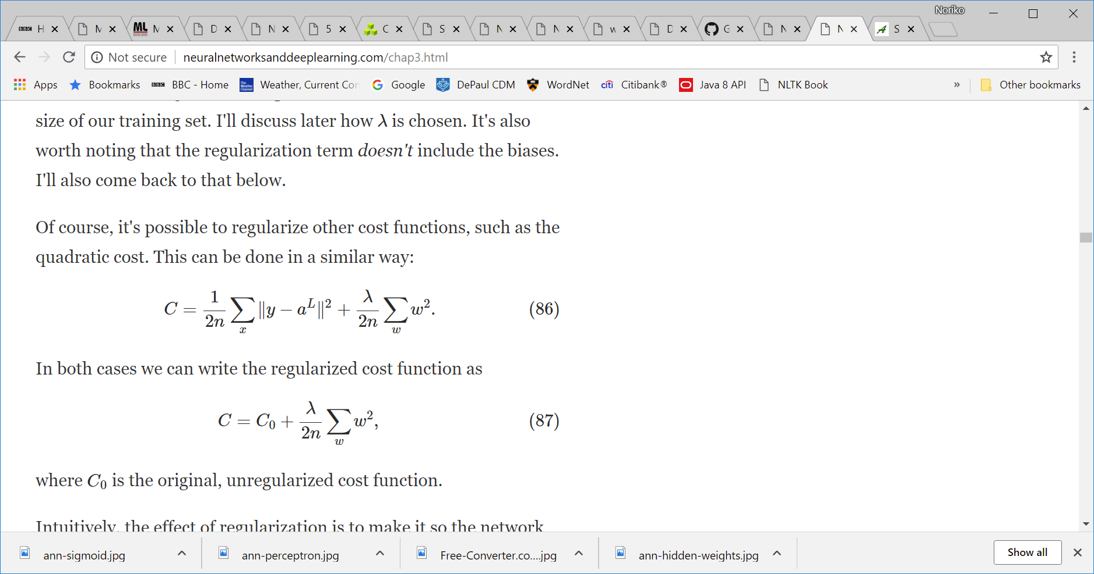
2.1 L2 Regularization
Weight decay.
Add an extra term, a quadratic values of the weights, in the cost function:
For Cross-Entropy:
For Quadratic:
The extra term causes the gradient descent search to seek weight vectors with small magnitudes, thereby reducing the risk of overfitting (by biasing against complex model).

Slide 15
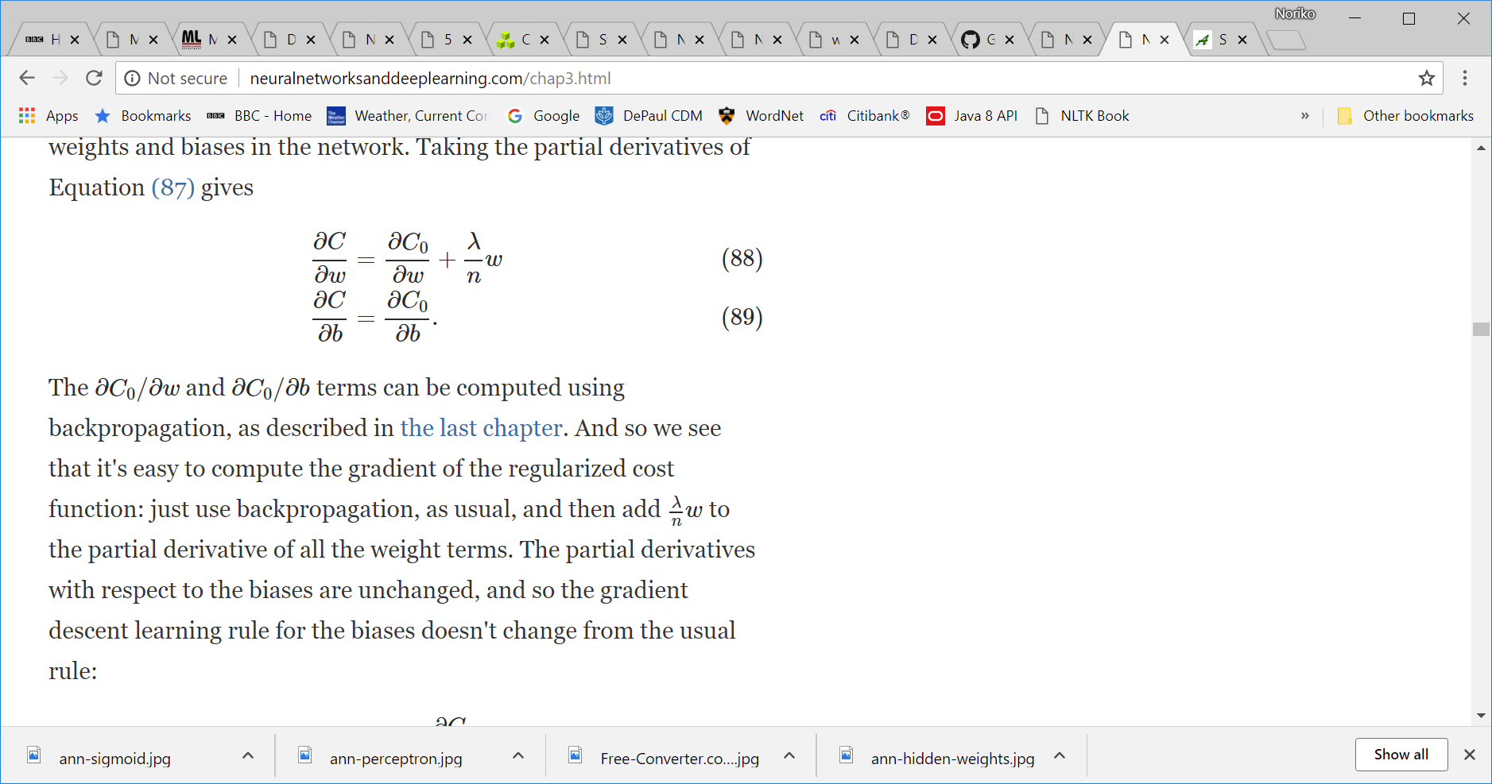
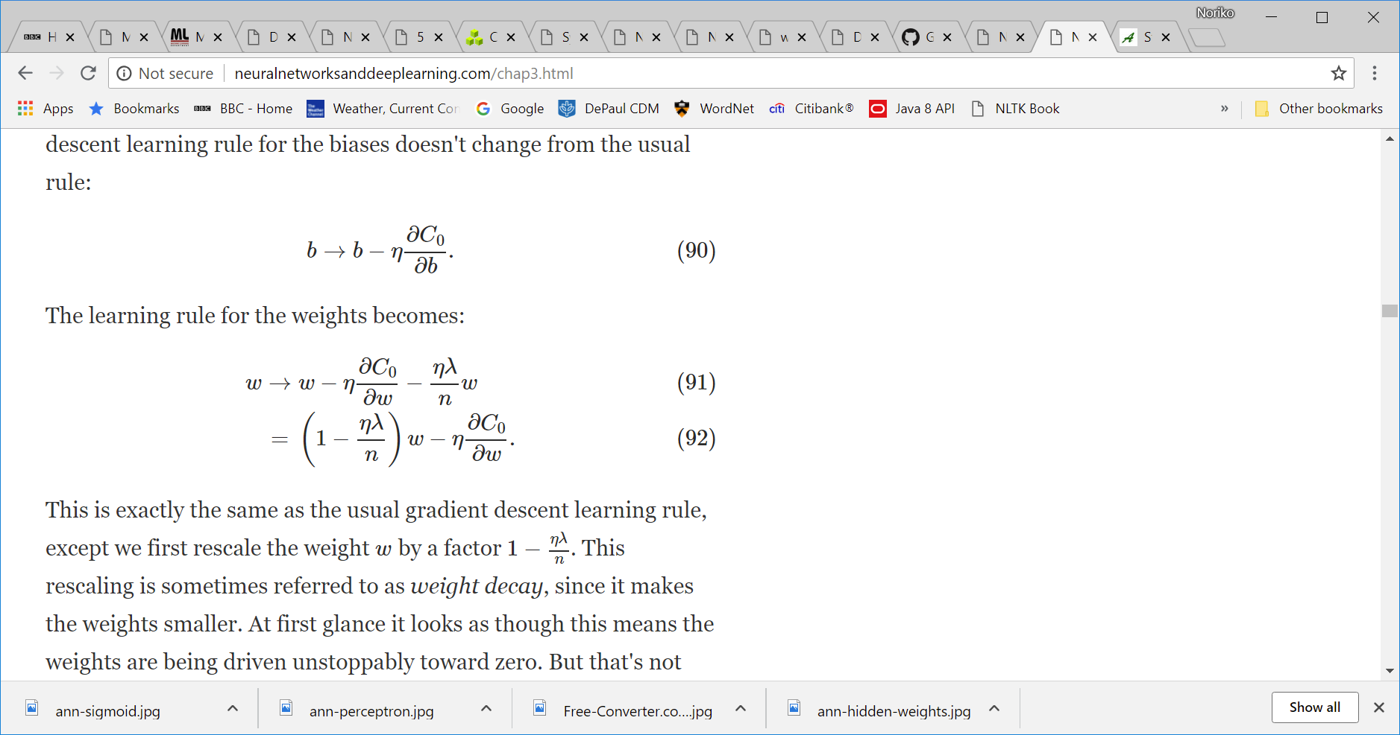
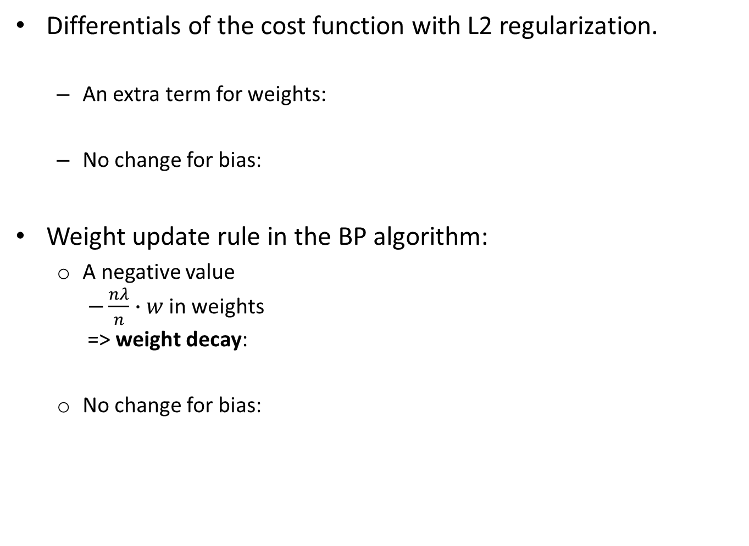
Differentials of the cost function with L2 regularization.
An extra term for weights:
No change for bias:
Weight update rule in the BP algorithm:
A negative value $−\frac{nλ}{n}∙w$ in weights => weight decay:
No change for bias:

Slide 16
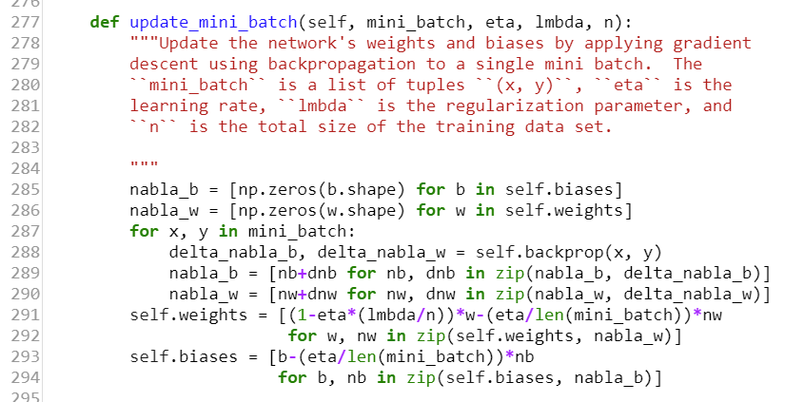

Slide 17
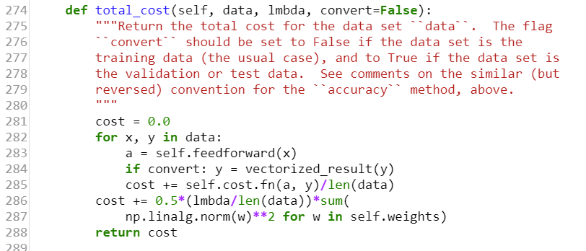

Slide 18
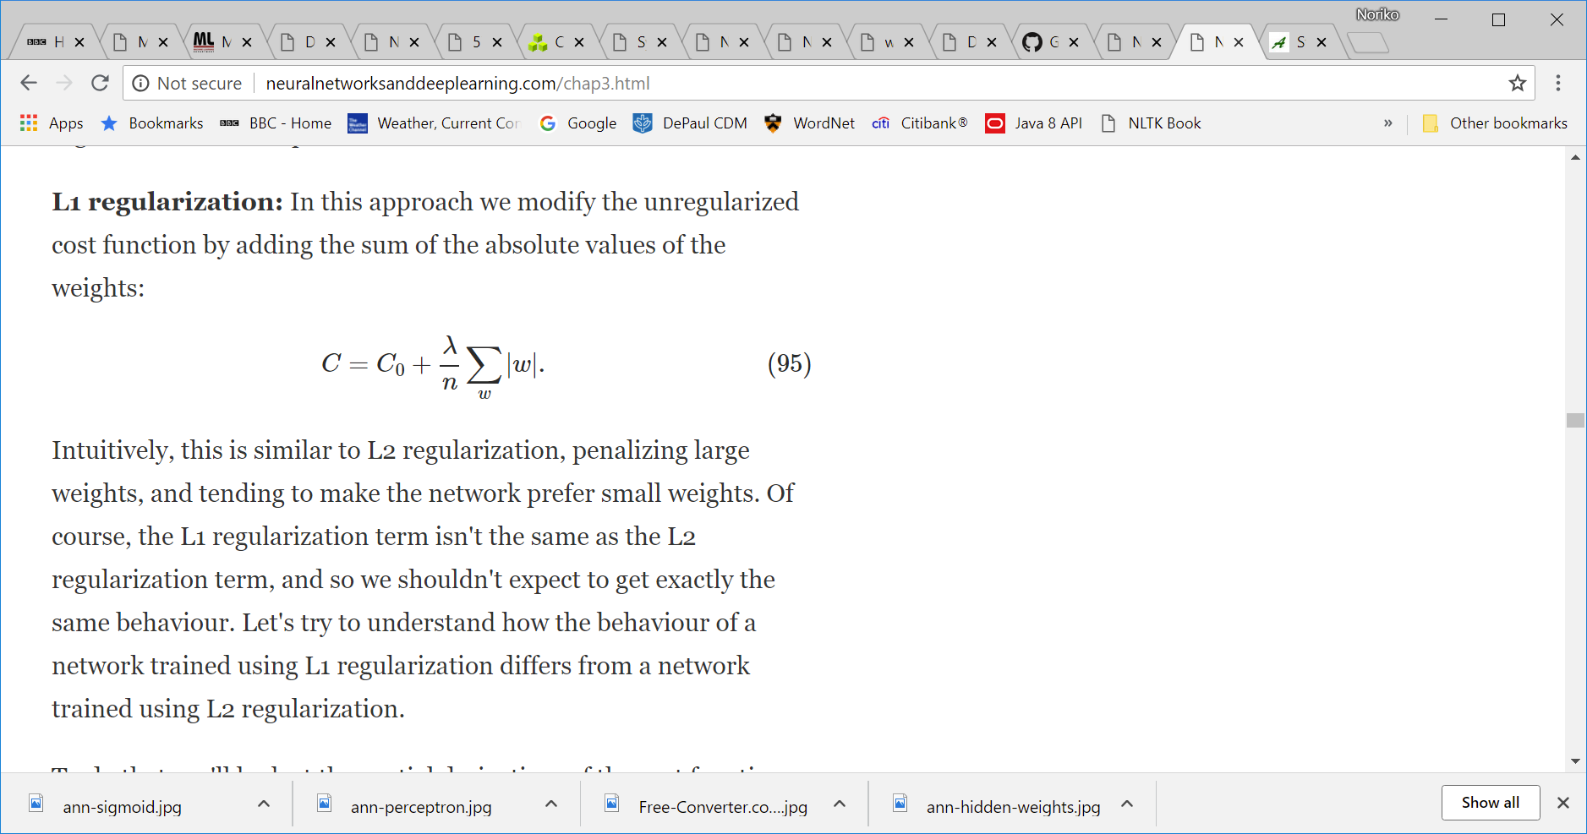
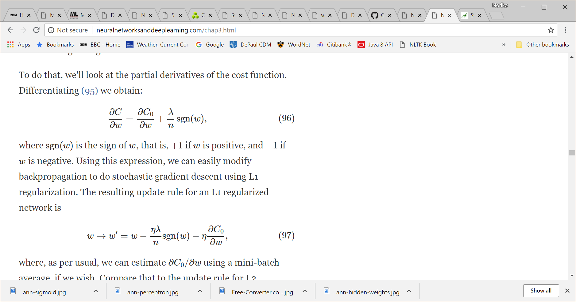
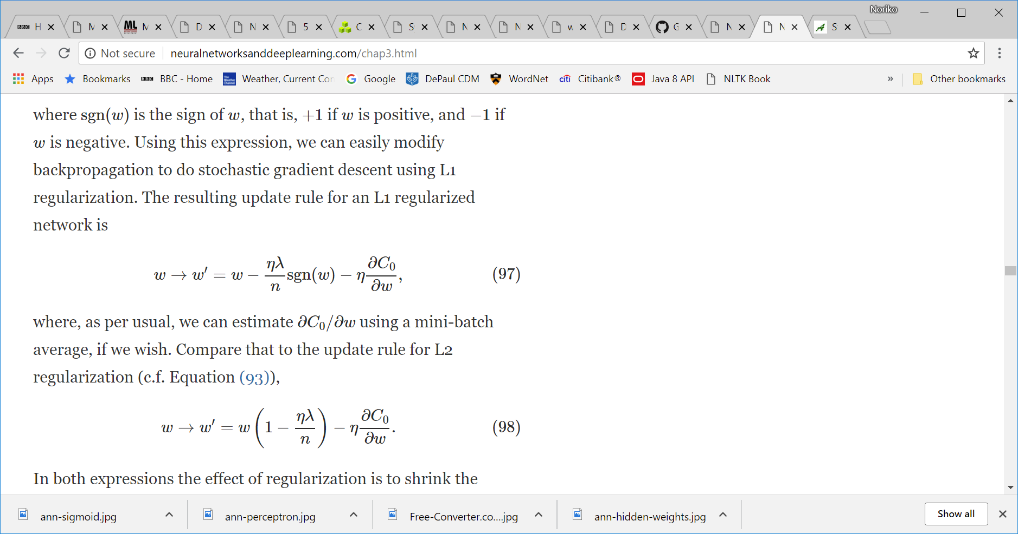
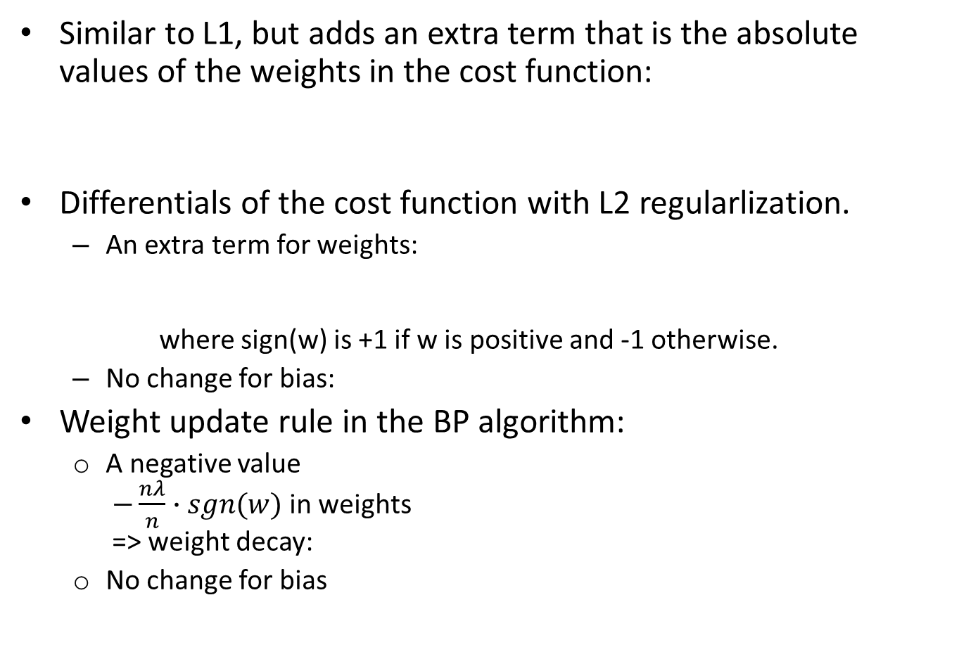
2.2 L1 Regularlization
Similar to L1, but adds an extra term that is the absolute values of the weights in the cost function:
Differentials of the cost function with L2 regularlization.
An extra term for weights: where sign(w) is +1 if w is positive and -1 otherwise.
No change for bias:
Weight update rule in the BP algorithm:
A negative value $−\frac{nλ}{n}∙sgn(w)$ in weights => weight decay:
No change for bias

Slide 19
L2 vs. L1
“In L1 regularization, the weights shrink by a constant amount toward 0.
In L2 regularization, the weights shrink by an amount which is proportional to w.
So when a particular weight has a large magnitude, |w|, L1 regularization shrinks the weight much less than L2 regularization does.
By contrast, when |w| is small, L1 regularization shrinks the weight much more than L2 regularization.
The net result is that L1 regularization tends to concentrate the weight of the network in a relatively small number of high-importance connections, while the other weights are driven toward zero.”

Slide 20
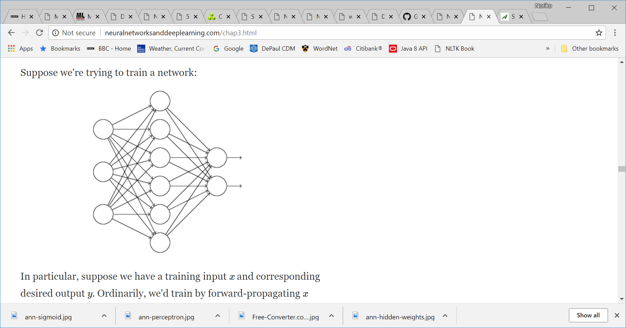

2.3 Dropout
Dropout ‘modifies’ the network by periodically disconnecting some nodes in the network.
“We start by randomly (and temporarily) deleting half the hidden neurons in the network, while leaving the input and output neurons untouched. We forward-propagate the input x through the modified network, and then backpropagate the result, also through the modified network. “
“We then repeat the process, first restoring the dropout neurons, then choosing a new random subset of hidden neurons to delete,..”

Slide 21
Robustness (and generalization power) of dropout:
“Heuristically, when we dropout different sets of neurons, it's rather like we're training different neural networks. And so the dropout procedure is like averaging the effects of a very large number of different networks. The different networks will overfit in different ways, and so, hopefully, the net effect of dropout will be to reduce overfitting.”
“we can think of dropout as a way of making sure that the model is robust to the loss of any individual piece of evidence.”
Dropout has been shown to be effective especially “in training large, deep networks, where the problem of overfitting is often acute.”

Slide 22
2.4 Artificial Expansion of Data
In general, neural networks learn better with larger training data.
We can expand the data by inserting artificially generated data instances obtained by distorting the original data.
“The general principle is to expand the training data by applying operations that reflect real-world variation.”

Slide 23
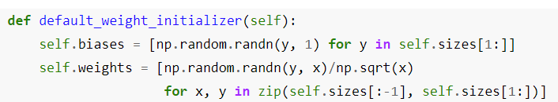
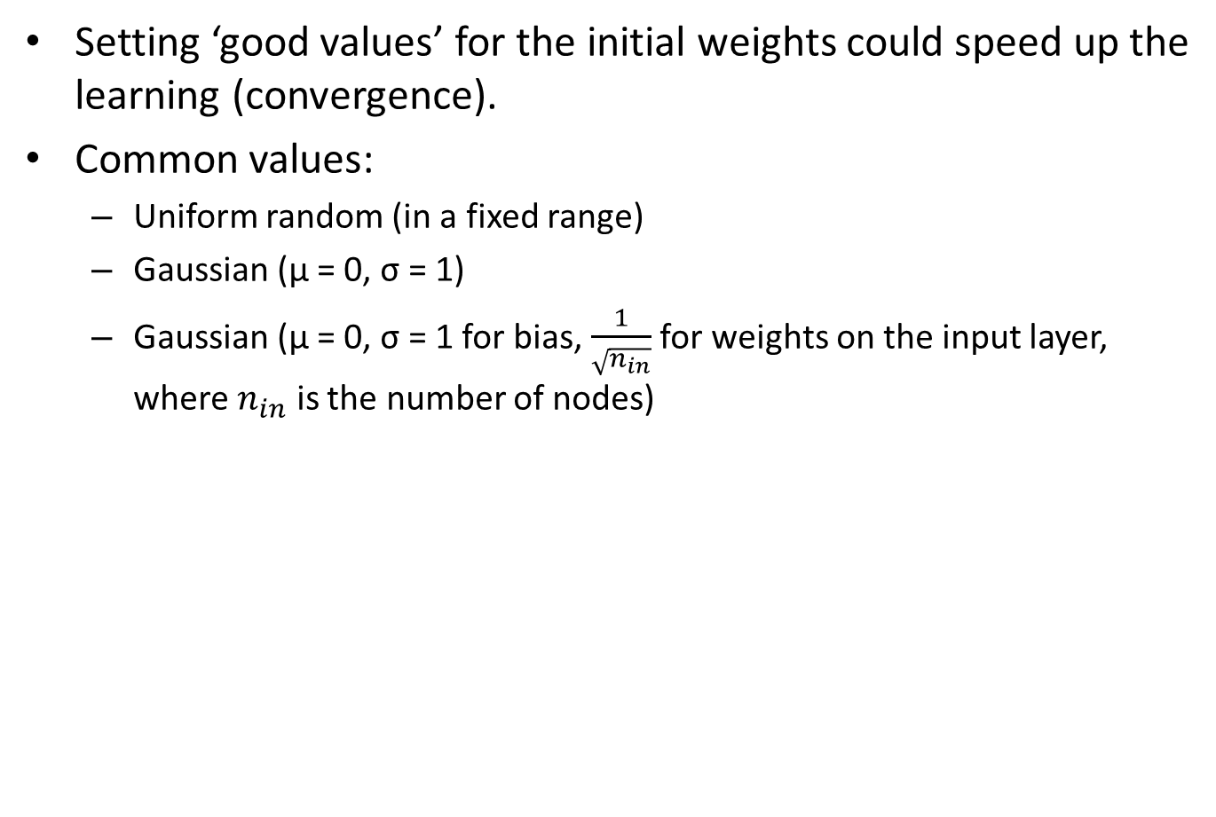
3 Initial Weights
Setting ‘good values’ for the initial weights could speed up the learning (convergence).
Common values:
Uniform random (in a fixed range)
Gaussian (µ = 0, σ = 1)
Gaussian (µ = 0, σ = 1 for bias, $\frac{1}{\sqrt{n_{in}}}$ for weights on the input layer, where $n_{in}$ is the number of nodes)

Slide 24
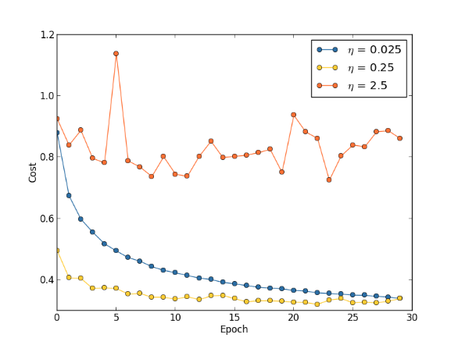
4 Hyper-parameters
How do we set ‘good values’ for hyper parameters such as η (learning rate), λ (regularization parameter) to speed up the experimentation?
A broad strategy is to try to obtain a signal during the early stages of experiment that gives a promising result. From there, you tweak hyper-parameters.
Heuristics for specific hyper-parameters.
Learning rate: Try values of different magnitude, e.g. 0.025, 0.25, 2.5
Number of epochs: Try early stopping and monitor overfitting.
Regularization parameter: Start with 0 and fix η . Then try 1.0, then * or / by 10.

Slide 25
5 Other Cost-minimization Techniques
In addition to Stochastic Gradient Descent, there are other techniques to minimize cost function:
Hessian technique
Momentum
Other learning techniques

Slide 26
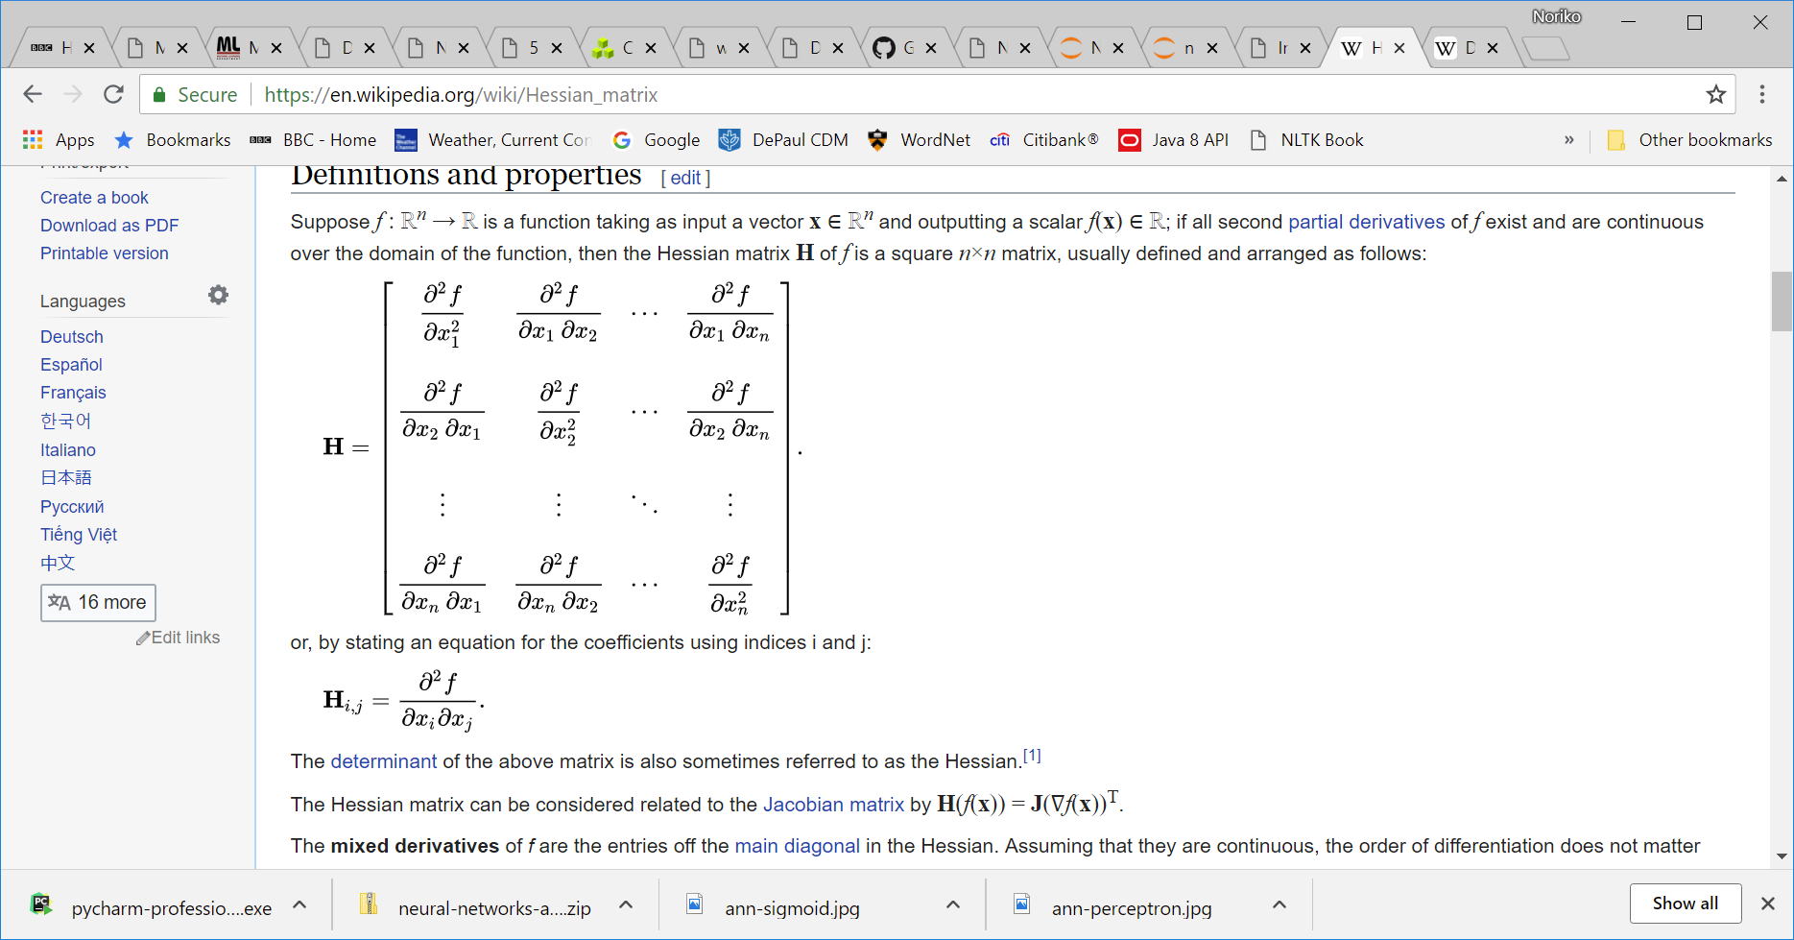
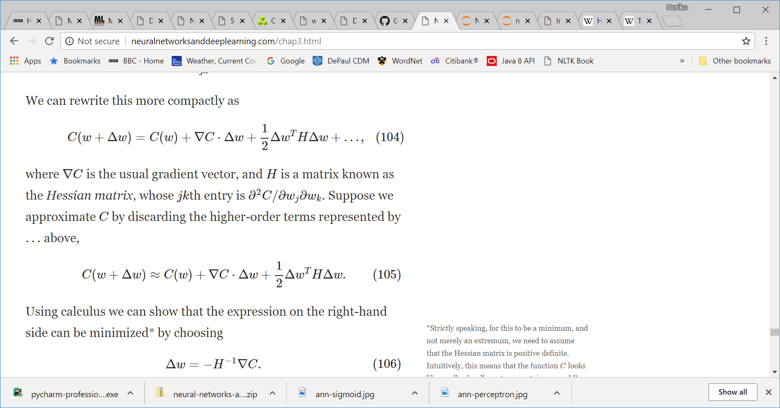
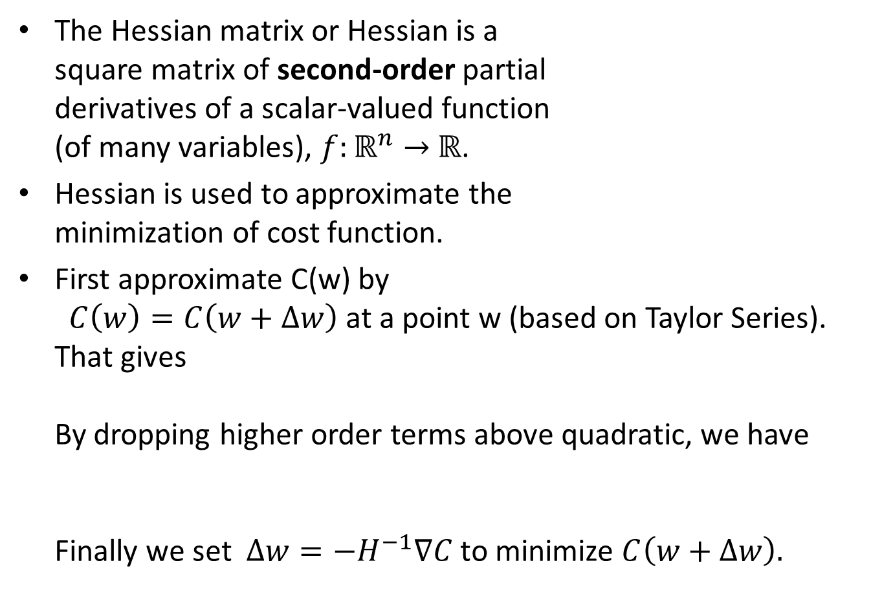
5.1 Hessian Technique
The Hessian matrix or Hessian is a square matrix of second-order partial derivatives of a scalar-valued function (of many variables), $f:ℝ^{n}→$ $ℝ$.
Hessian is used to approximate the minimization of cost function.
First approximate C(w) by $C\left(w\right)=C\left(w+∆w\right)$at a point w (based on Taylor Series). That gives By dropping higher order terms above quadratic, we have Finally we set $∆w=−H^{−1}∇C$ to minimize $C\left(w+∆w\right).$

Slide 27
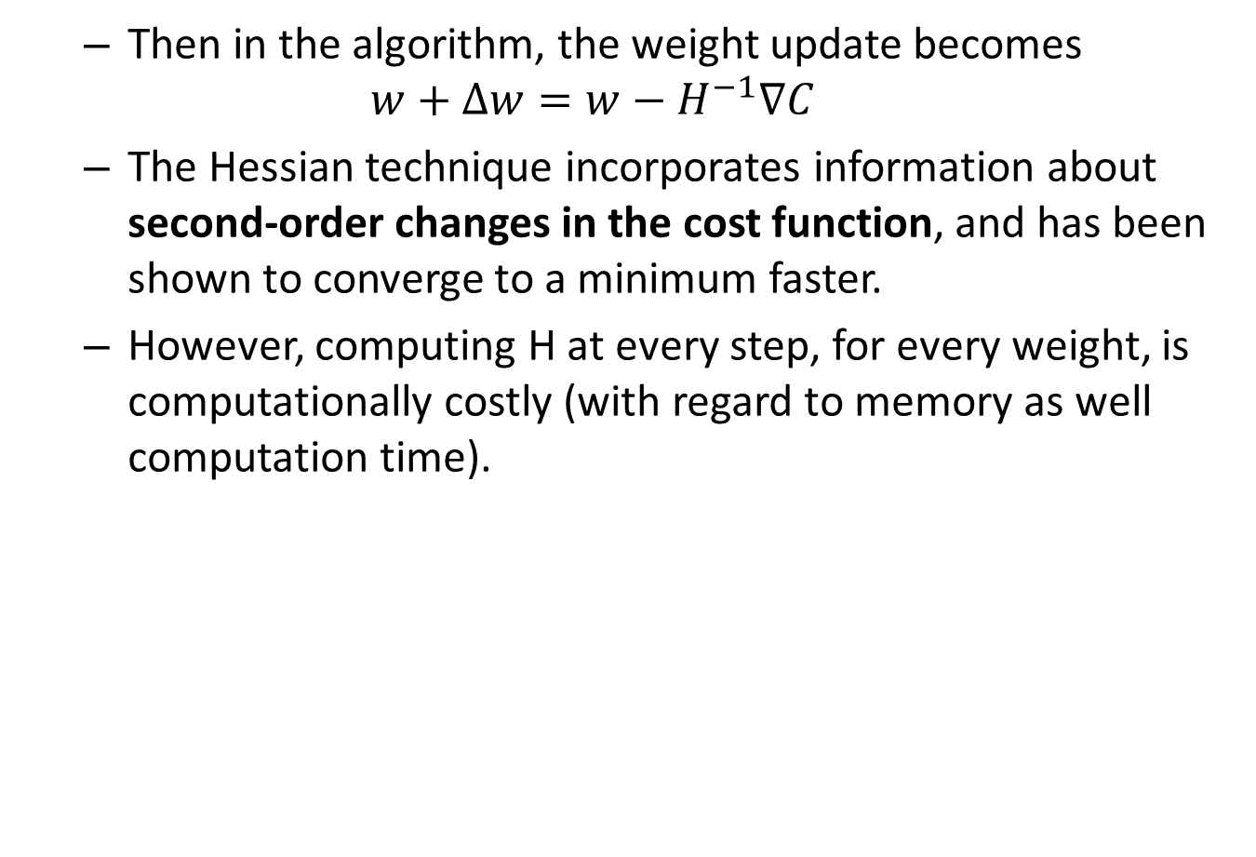
Then in the algorithm, the weight update becomes
$$w+∆w=w−H^{−1}∇C$$
The Hessian technique incorporates information about second-order changes in the cost function, and has been shown to converge to a minimum faster.
However, computing H at every step, for every weight, is computationally costly (with regard to memory as well computation time).

Slide 28
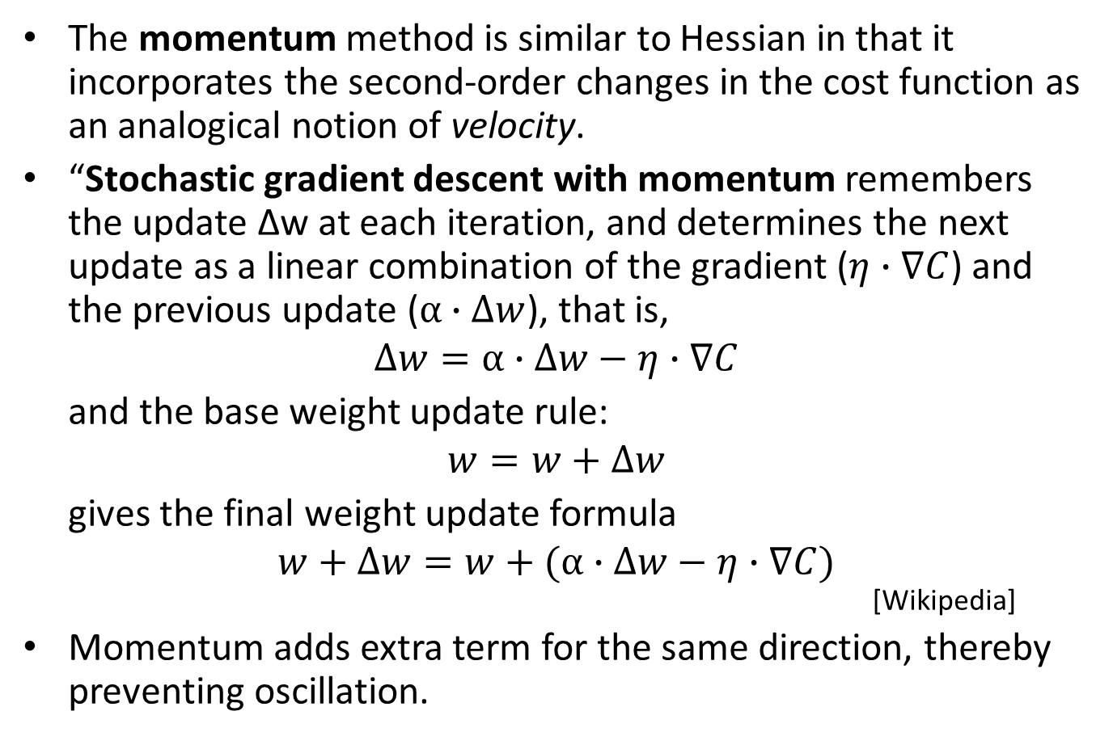
5.2 Momentum
The momentum method is similar to Hessian in that it incorporates the second-order changes in the cost function as an analogical notion of velocity.
“Stochastic gradient descent with momentum remembers the update Δw at each iteration, and determines the next update as a linear combination of the gradient ($η∙∇C$) and the previous update ($α∙∆w$), that is,
$$∆w=α∙∆w−η∙∇C$$
and the base weight update rule:
$$w=w+∆w$$
gives the final weight update formula
$$w+∆w=w+(α∙∆w−η∙∇C)$$
[Wikipedia]
Momentum adds extra term for the same direction, thereby preventing oscillation.

Slide 29
5.3 Other Learning Techniques
Resilient Propagation:
Use only the magnitude of the gradient and allow each neuron to learn at its own rate. No need for learning rate/momentum; however, only works in full batch mode.
Nesterov accelerated gradient:
Helps mitigate the risk of choosing a bad mini-batch.
Adagrad:
Allows an automatically decaying per-weight learning rate and momentum concept.
Adadelta:
Extension of Adagrad that seeks to reduce its aggressive, monotonically decreasing learning rate.
Non-Gradient Methods:
Non-gradient methods can sometimes be useful, though rarely outperform gradient-based backpropagation methods. These include: simulated annealing, genetic algorithms, particle swarm optimization, Nelder Mead, and many more.

Slide 30
6 Other Neuron Types
In addition to sigmoid, there are other types of neurons(with different activation functions), for example:
Tanh
Rectified Linear Unit (ReLU)
Softmax
A good reference on various activation functions is found at https://ml-cheatsheet.readthedocs.io/en/latest/activation_functions.html?highlight=softmax

Slide 31
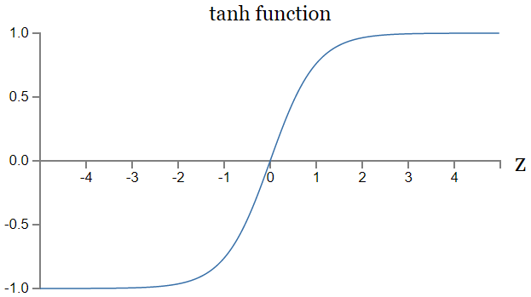
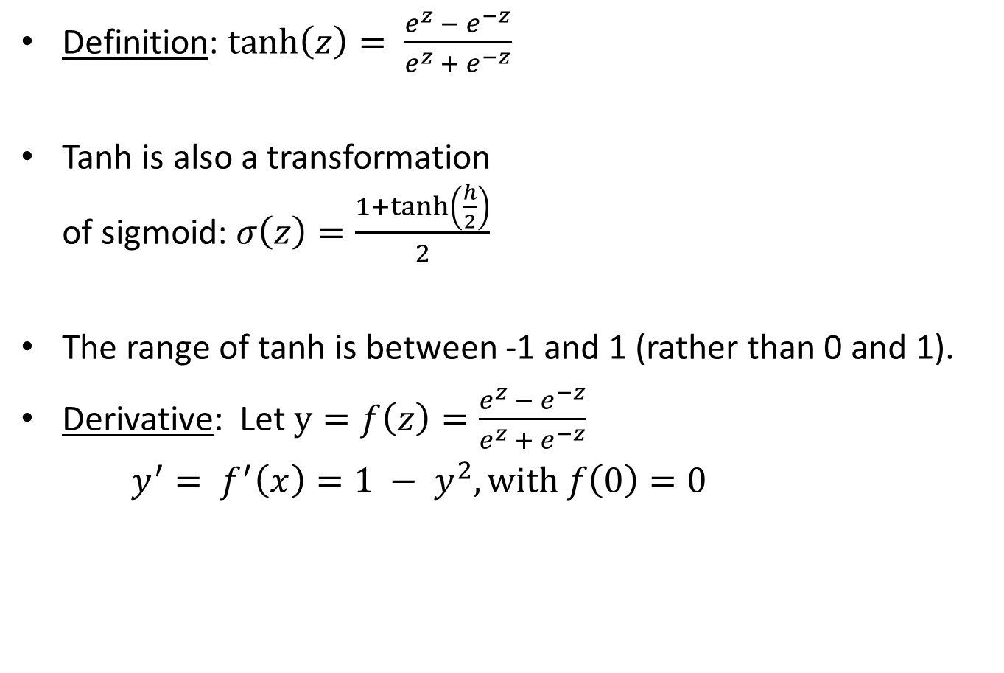
6.1 Tanh (Hyperbolic Tangent)
Definition: $\tanh\left(z\right)= \frac{e^{z} − e^{−z}}{e^{z} + e^{−z}}$
Tanh is also a transformation of sigmoid: $σ\left(z\right)=\frac{1+tanh⁡\left(\frac{h}{2}\right)}{2}$
The range of tanh is between -1 and 1 (rather than 0 and 1).
Derivative: Let $y=f\left(z\right)=\frac{e^{z} − e^{−z}}{e^{z} + e^{−z}}$
$y^{′}= f^{′}\left(x\right)=1 − y^{2}, with f\left(0\right)=0$

Slide 32
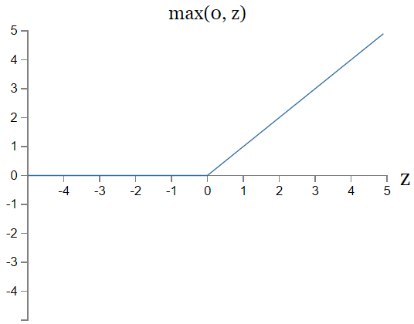
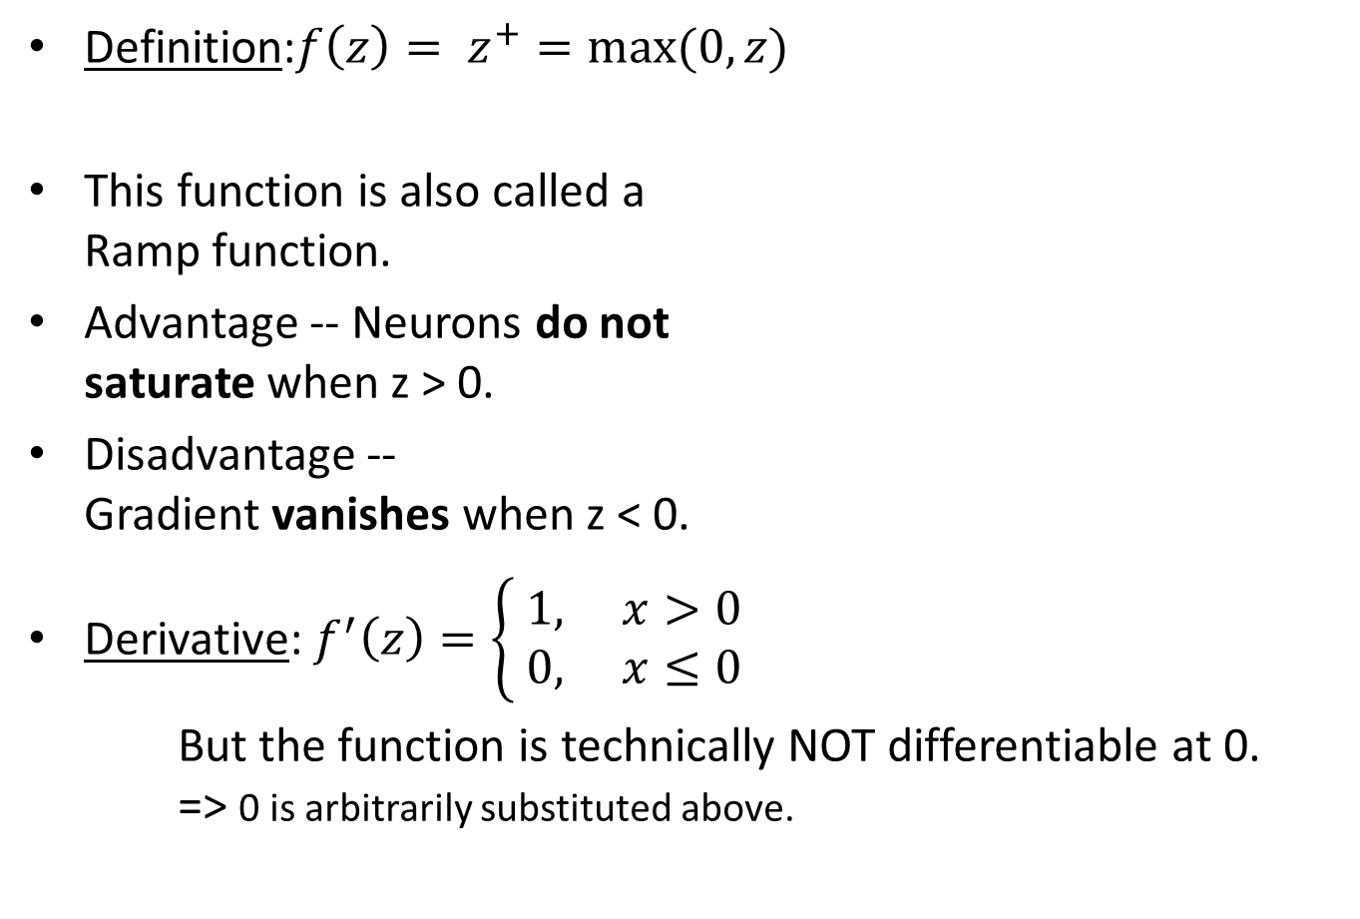
6.2 ReLU (Rectified Linear Unit)
Definition:$f\left(z\right)= z^{+}=max⁡(0, z)$
This function is also called a Ramp function.
Advantage -- Neurons do not saturate when z > 0.
Disadvantage -- Gradient vanishes when z < 0.
Derivative: $f^{′}\left(z\right)=\left\{\begin{aligned} 1, x>0 \\ & 0, x≤0\end{aligned}\right.$
But the function is technically NOT differentiable at 0. => 0 is arbitrarily substituted above.

Slide 33
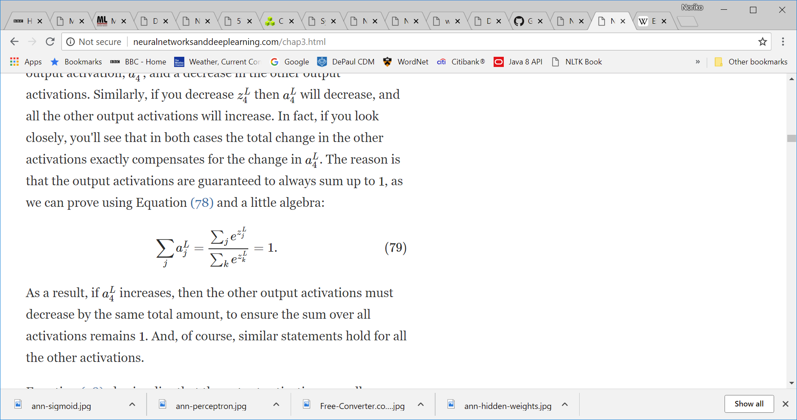

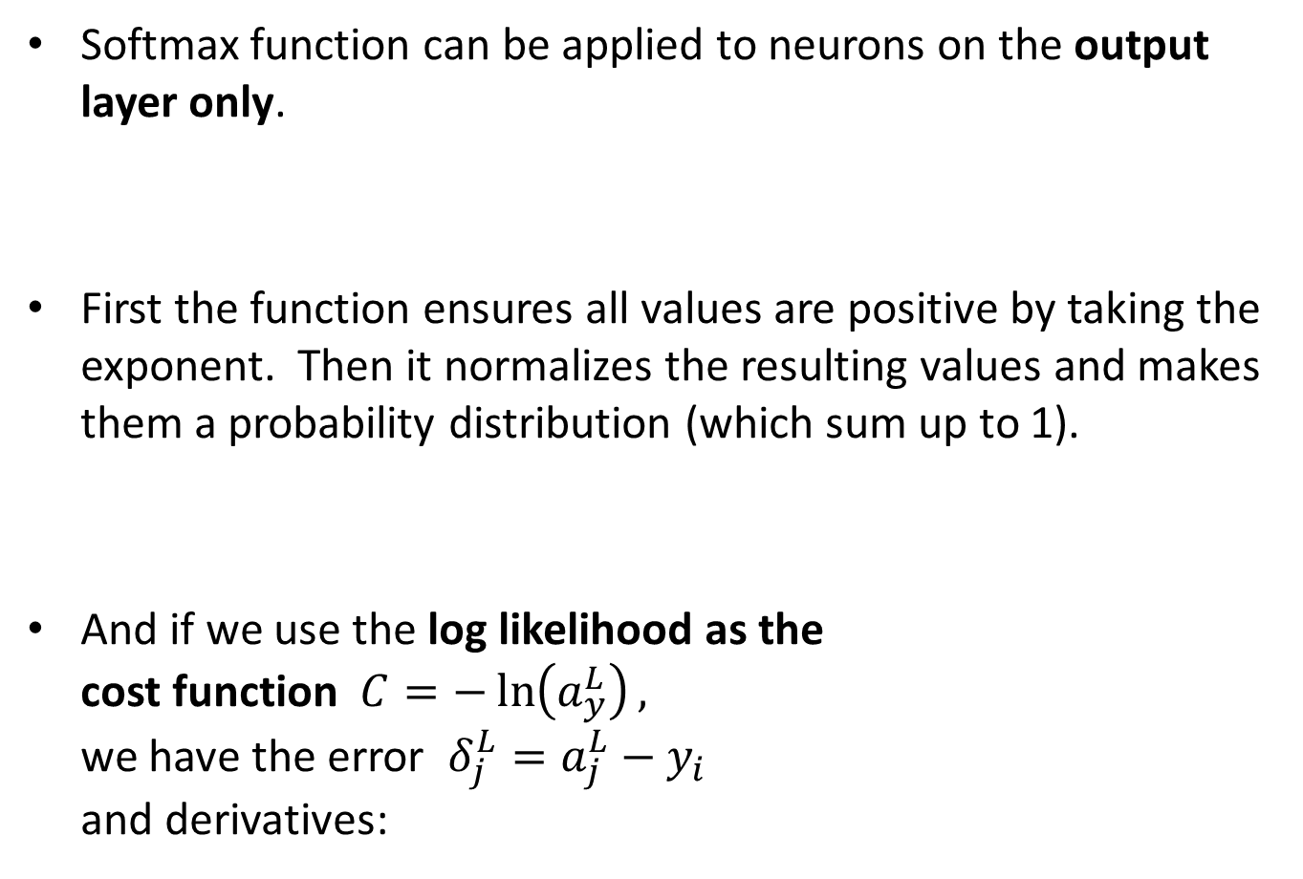
6.3 Softmax
Softmax function can be applied to neurons on the output layer only.
First the function ensures all values are positive by taking the exponent. Then it normalizes the resulting values and makes them a probability distribution (which sum up to 1).
And if we use the log likelihood as the cost function $C=−\ln\left(a_{y}^{L}\right),$ we have the error $δ_{j}^{L}=a_{j}^{L}−y_{i}$ and derivatives:
where $z_{j}^{L}=\sum_{m}{w_{jm}^{L}∙a_{m}^{L−1}+b_{j}^{L}}$

Slide 34
“But (recap), the Softmax activation function is only useful for networks with more than one output neuron. It ensures that all of the output neurons sum to 1.0. This makes it very useful for classification where it shows the probability of each of the classes as being the correct choice.”

Slide 35
7 Two Problems to review
1. Vanishing Gradient problem
With gradient descent, sometimes the gradient becomes vanishingly small, effectively preventing the weight from changing its value. In the worst case, this may completely stop the neural network from further training.
2. Neuron Saturation
When a neuron’s activation value becomes close to the maximum or minimum of the range (e.g. 0/1 for sigmoid, -1/1 for tanh), the neuron is said to be saturated. In those cases, the gradient becomes small (vanishing gradient), and the network stops learning.

